Slide 1
Movie Trends
Genres over the years

Slide 2
Project Overview
01
02
03
04
Origins
Source
Imdb data
What is the changing trend in most produced movie genres over the decades
Indicators
Conclusion
Number of movies produced throughout decades in each genre
User ratings and votes
Changing variation: Trends over the decades
Non-changing variation: Correlation between the top ranked and top voted movies

Slide 3
Project Hypothesis and Questions
Hypothesis: There is a significant change in the movie industry in terms of genres and number of productions. My personal hypothesis is: Movies reflect the spirit of each decade. We can see it through the most demanded and produced movie genres throughout the years.
How can we see the outcomes through data?
In order to find an answer to this question and see the trends, I used the most popular website that reflect the users’ choices: IMDB.
The Project aims to define genre trends for movies throughout the years relying on the data from IMDB. The main question is, which genres became more popular throughout the decades? Does people’s ratings indicate the demand for these genres?

Slide 4
Project Overview
Three different Datasets were used, including 9826 movies between the years 1905 to 2023.
Datasets were found from Kaggle and to have more relevant results, only movies released between 1950s and 2023 were used.
Datasets were cleaned from null values and irrelevant columns including details on the movie: the cast, director, writer, runtime etc.
Results relied on the most relevant columns: «genre», «year», «number of votes», «movie ratings».

Slide 5
Project Overview
Hypothesis: Does IMDB reflects reliable reflections for movie producers? If yes, what are the main genres for production companies should invest on, according to users’ preferences?
The Project aims to define genre trends for movies throughout the years relying on the data from IMDB.
In order to find an answer to this question and see the users’ reaction to the movies, I used the most popular website that reflect the users’ choices: IMDB.
As the trends change over the decades, my conclusions relied on data for each decade and examine the genre preferences among the users.

Slide 6
Data Wrangling and Cleaning
Datasets were found from Kaggle and only movies from 1950s to nowadays were used to show more relevant results.
Genre column included several genre for one movie, although all the genre tags were used in the overall analysis.
Datasets were cleaned from null values and irrelevant columns.
Cleaning challenges:
Formatting issues
- Challenges included small typos in the syntax to achieve the results
Different values in the same columns
- Release dates were converted to year and relevant years were extracted

Slide 7
Patterns
The most relevant genres remains to be Drama and Comedy for all times, according the number of all movies produced since 1970s.
The users tend to show the highest number of participation on the most rated movies: The pattern shows that users tend to give more reaction to the movies they enjoyed the most. This pattern shows that the increased number of IMDB voting participation is reliable and ratings on IMDB actually indicates the popularity by the people.

Slide 8
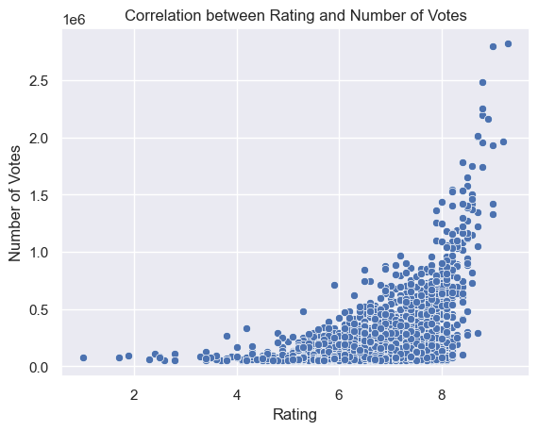
Key findings
The graphic includes all user ratings and votes from the whole data.
It shows that there is a correlation between the number of user votes and rating numbers: more users tend to vote for the most liked movies.
This was the first outcome to see reliability of the users on movie ratings and trends.

Slide 9
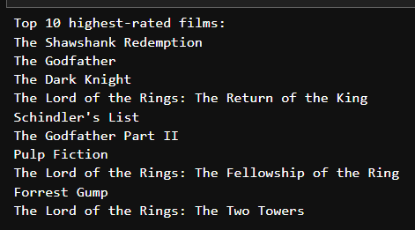
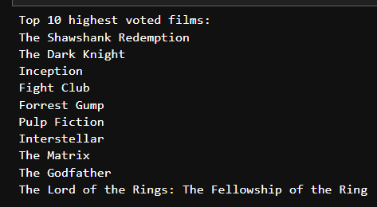
Key findings

Slide 10
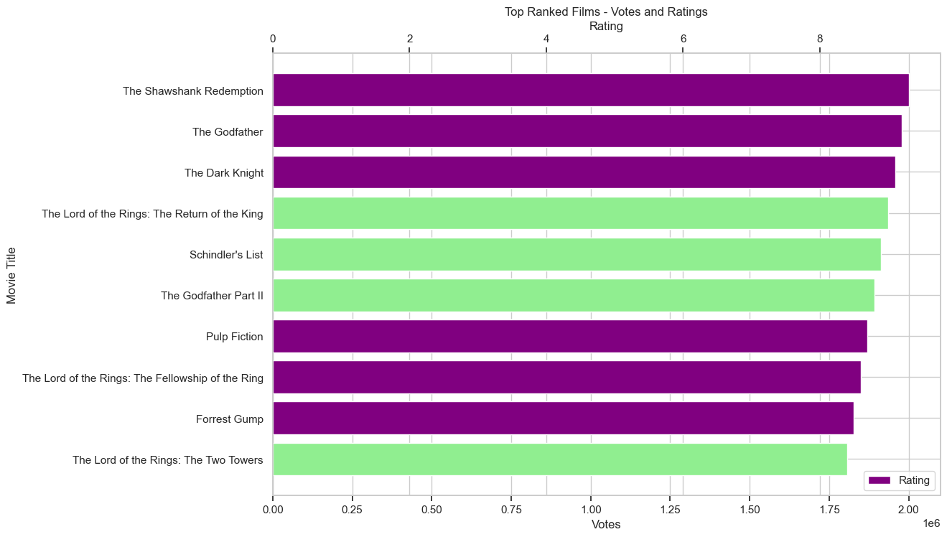
Participation Pattern

Slide 11
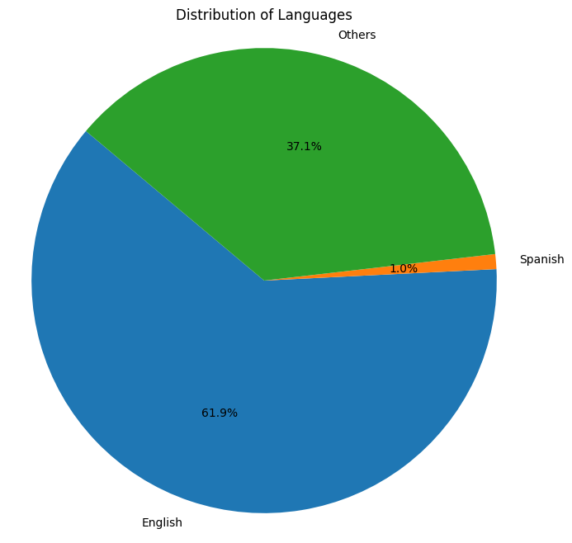
Key findings
Key finding:
English-speaking movies remained domaniting the total number of released movies around the world.

Slide 12
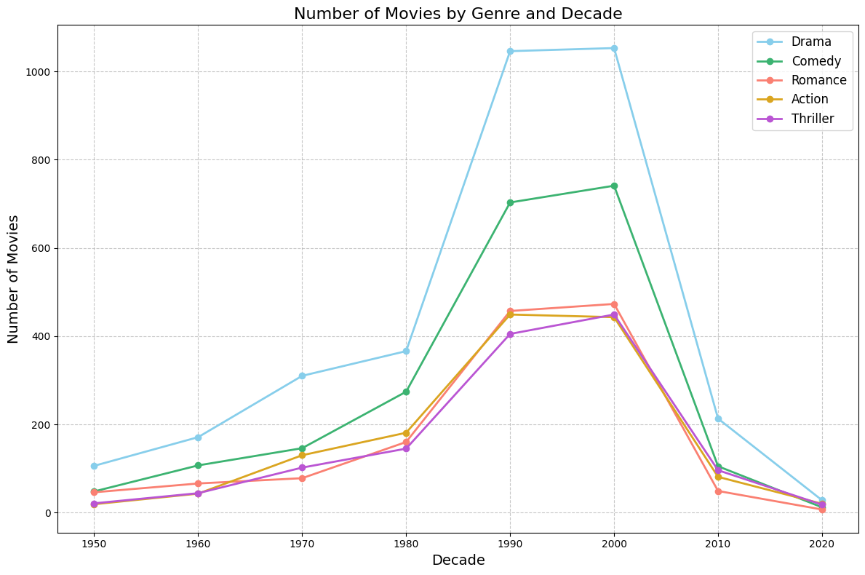
Genres through the Decades
Genre order shows similar order.
Number of the movies released had a significant increase in the 1980s and had its peak in the year 2000.
Number of the movies released has a significant decline in the 2000s and 2010s.

Slide 13
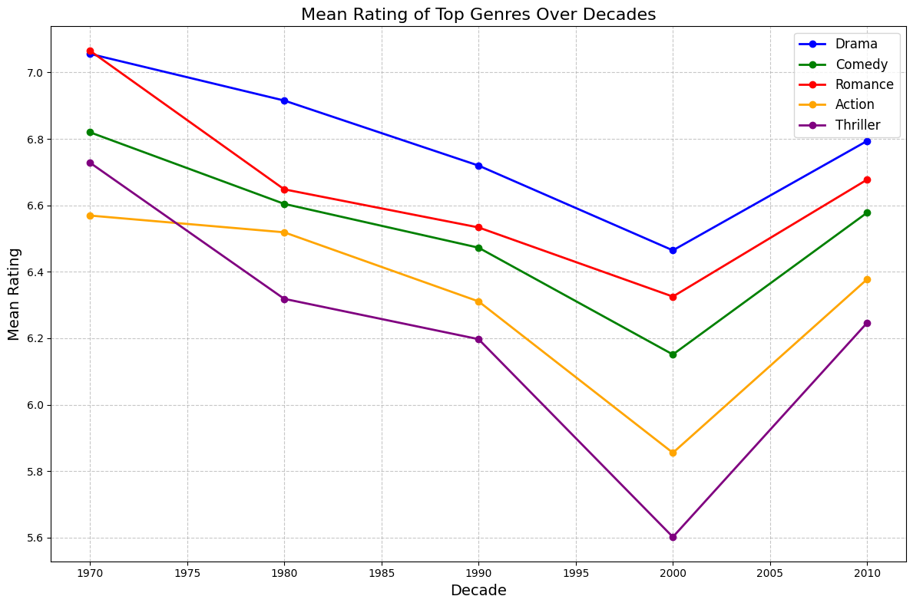
Genres through the Decades
Key finding:
Ratings of the movies released in 1990s have a serious decline until 2000, while numbers remain similar throughout the 1990s as we see in the previous slide.
This indicates a shift in the movie industry with the year 2000.

Slide 14
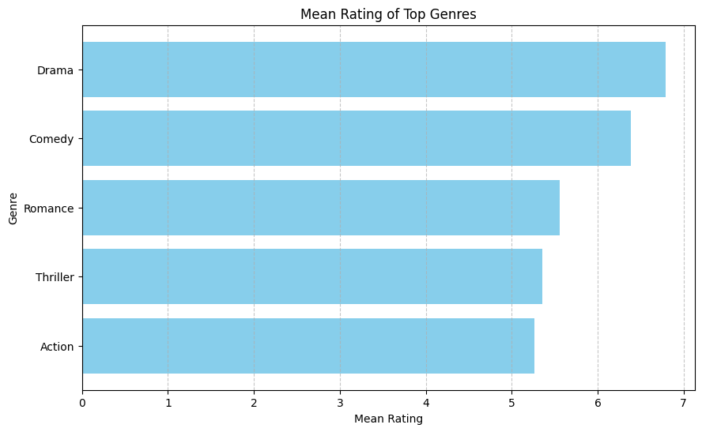
Key findings
Trends on the most rated genres throughout the decades from the most prefered genres :
Drama
Comedy
Romance
Action
Thriller

Slide 15
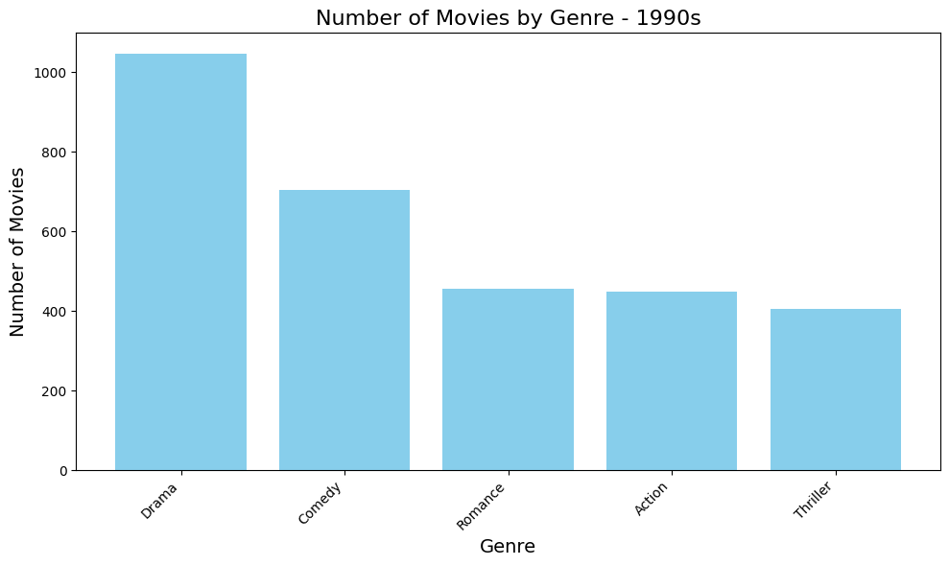
Key findings
Key finding:
Drama genre signicicantly dominated the number of movies released in the 90s.

Slide 16

Key findings
Key finding:
Trends in the 2000s looks almost identical to the trends in the 1990s.

Slide 17
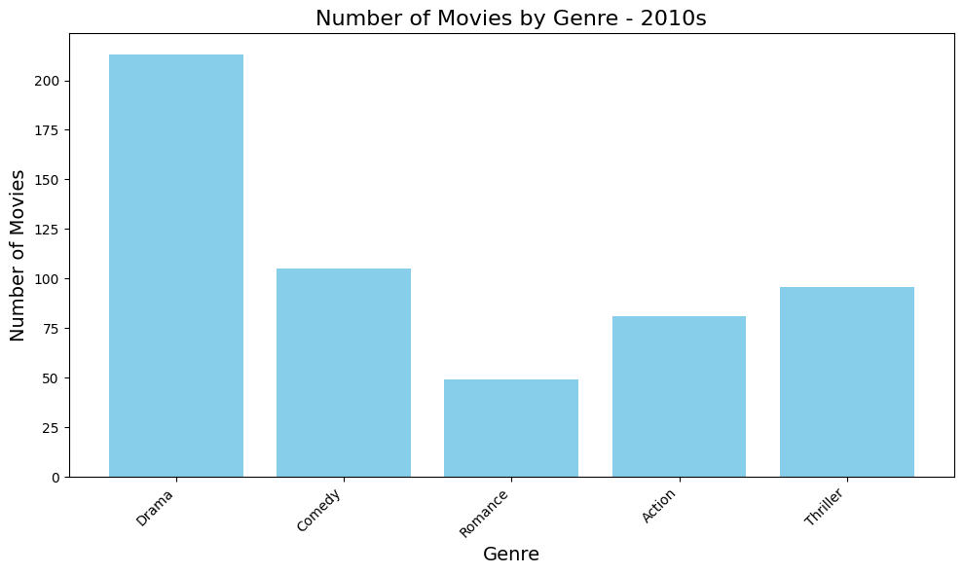
Key findings
There is a significant shift in the trends comparing the 90s and 00s:
Significant increase of Drama genre popularity
Number of movies released in drama and
Comedy genres have significant number gap comparing previous decades.
Demand on Romance has the highest drop in total.
Action and Thriller genre has highest production numbers for the first time than Romance genre.

Slide 18
Major Obstacle
What was the biggest obstacle during this project?
Time restriction : Error handling in cleaning data and data visualisation processes.
Working on new environment and technical difficulties.
Duplicated values on genres: Most movies were tagged under several genres.
What could be done differently?
Planning time management better and focus on the outcome.

Slide 19
Conclusion
Users tend to show the highest reaction on movies they rate high and their reaction reflect the genres that are demanded the most.
Comedy and Romance genres are in decline in the top-produced movies and most rated movies. Production companies can use IMDB outcomes for risk-free investment.
Production companies can also use IMDB data to have insights on the trends and preferences.
The decline in Comedy and Romance genre can be used for other studies to identify decade trends as one of the indicators of the Zeitgeist of the decade.

Slide 20
Thanks!
Alev Yildirim

